Slide 1
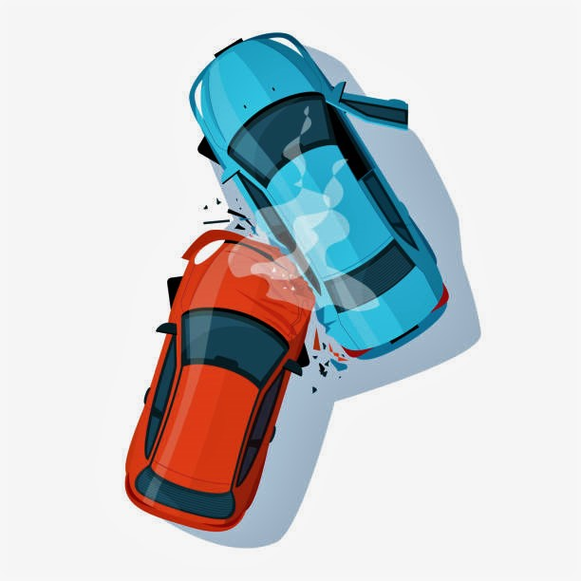

Traffic accidents in the US
Biplob Gauli
MSDS 696
Regis University

Slide 2
Problem description
PER ASIRT, Road crashes are the leading cause of death in the U.S. for people aged 1-54
ACCIDENTS CAUSE 38,000 DEATHS ANNUALLY
4.4 million are injured seriously enough to require medical attention

Slide 3
RESEARCH topics
does visibility impact the severity of the accidents?
Poor visibility makes People slow but still can’t avoid accidents?
Drivers can speed in better visibility giving them less time to stop when needed?
What hours of the day has the most and least number of accidents?
Drivers may choose to avoid the hours when accidents are more prone
Is traffic light better at reducing the severity compared to a roundabout ?
City planners can use this information.

Slide 4
Dataset
data by Sobhan Moosavi for accidents in us from 2016 to 2021.
records of around 2.8 million data covers 49 states of the US.
Based on data captured by a variety of entities, such as the US and state department of transportation, law enforcement agencies, traffic cameras, and traffic sensors.
there are 47 features in the data.
Data includes date, time, location, weather conditions, road features and traffic features near the place of accident.

Slide 5
Planned Process
Data cleaning and preprocessing
Explanatory data analysis
Answers to the research question
Correlation analysis and Feature selection
Machine learning models to predict the severity of an accident
COmpare KNN, SVM, Random Forest and Neural Network

Slide 6
Data cleansing
The dataset had 47 columns with the total file size being over 1 gb
Removed 22 columns that were not related to this project
Removed duplicates and empty values

Slide 7
Exploratory Data Analysis

Slide 8
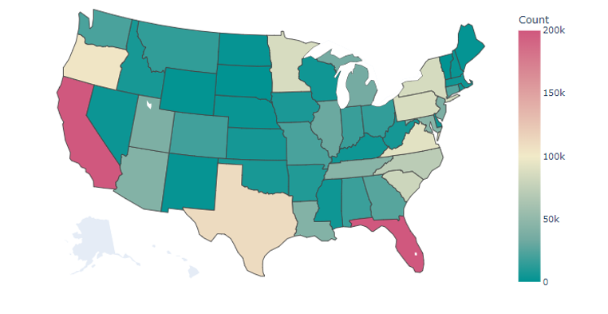
Accidents by State

Slide 9
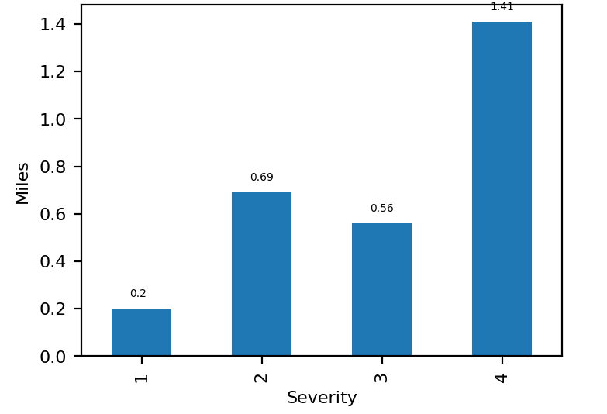
Severity and impact

Slide 10
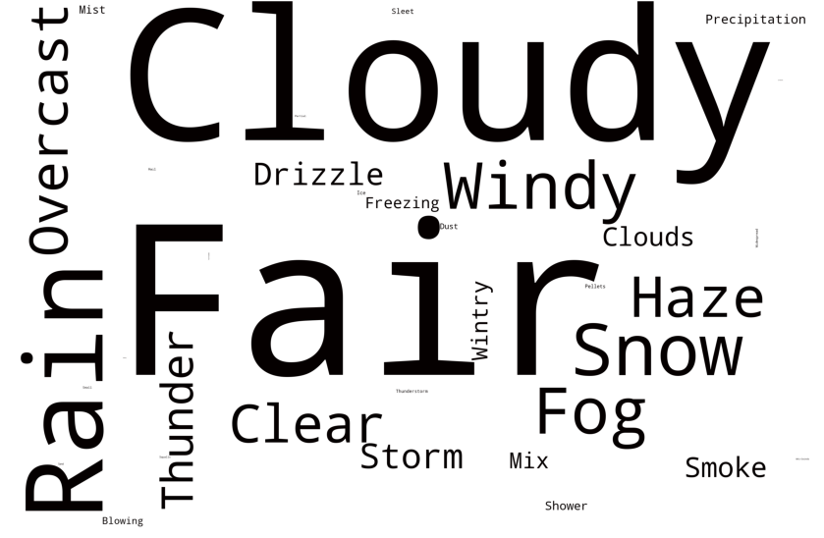
Weather condition cloud

Slide 11
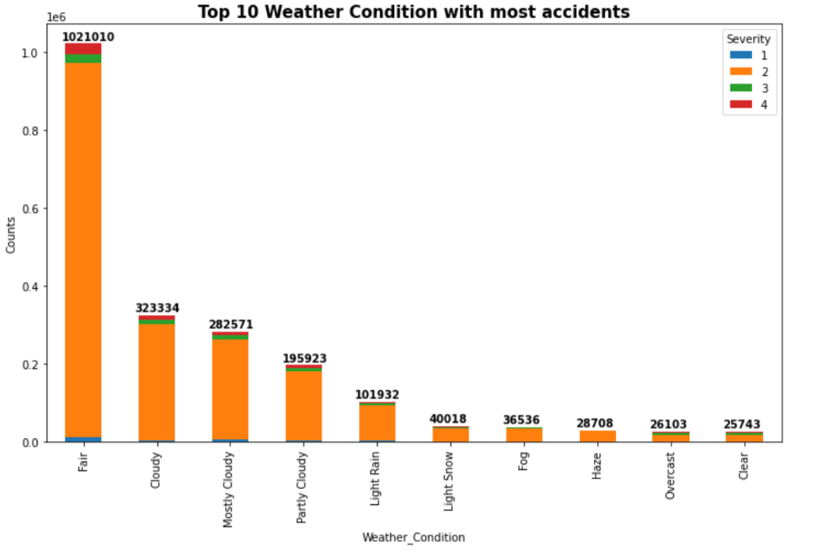
Top weather conditions

Slide 12
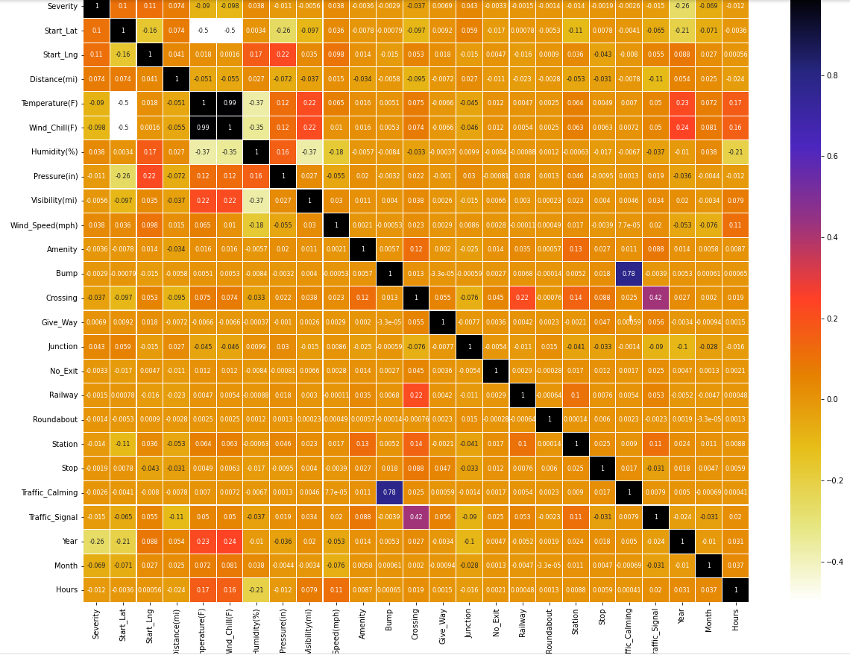
Correlation Plot

Slide 13
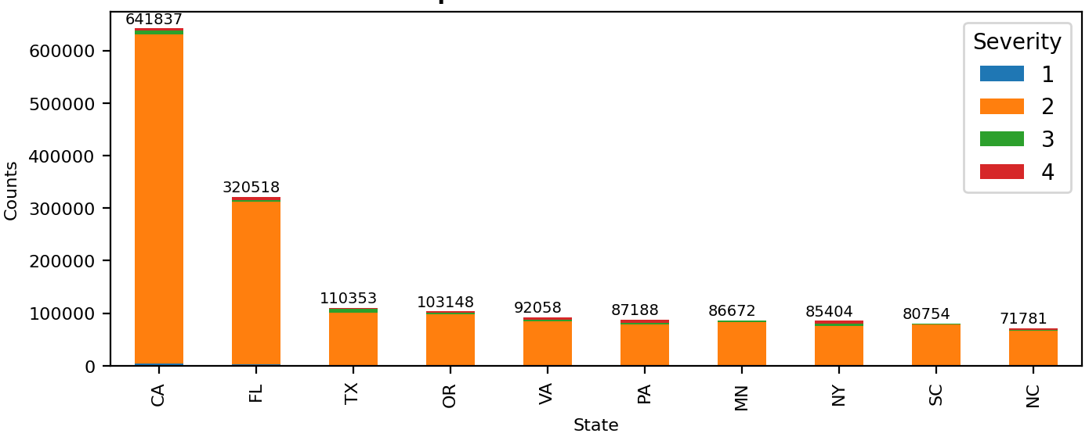
States with most accidents

Slide 14
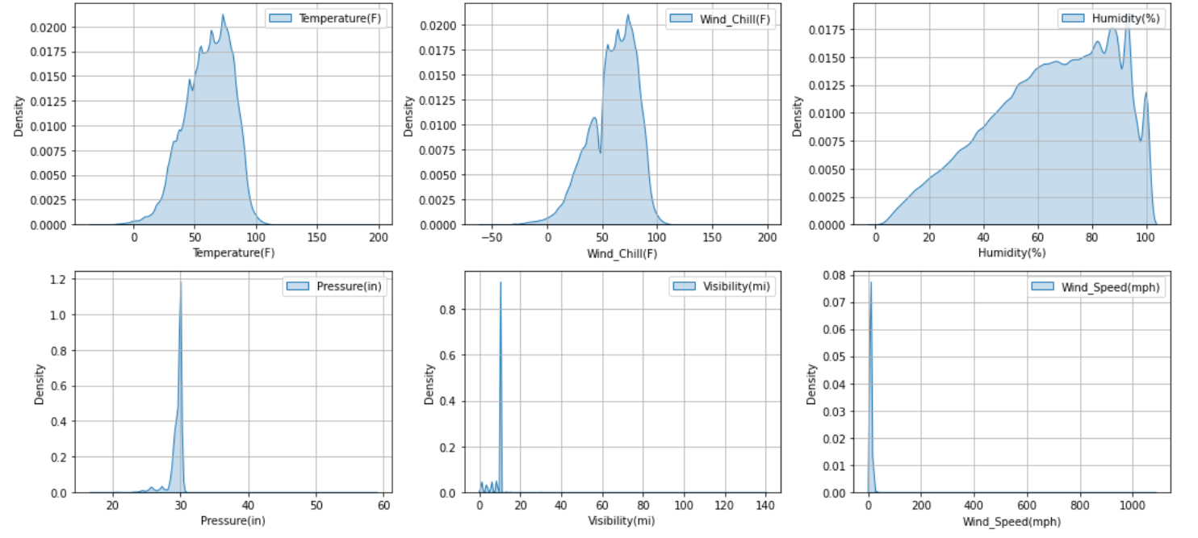
Density Graph for Weather

Slide 15
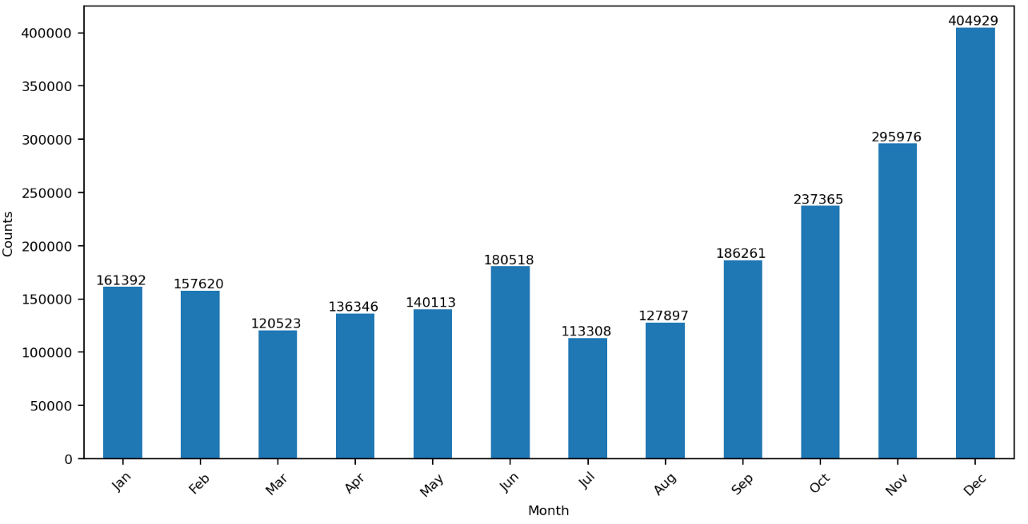
Accidents by Month

Slide 16
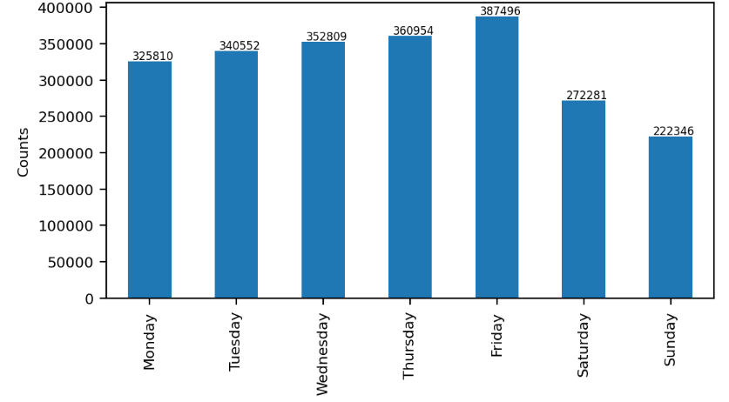
Accidents by Day of week

Slide 17
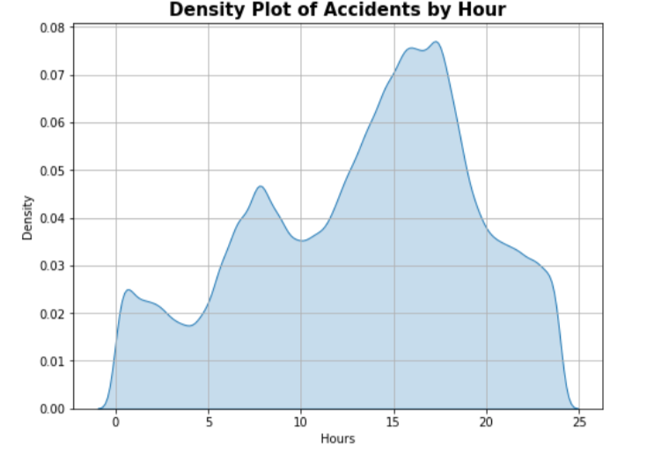
Hourly Density plot

Slide 18
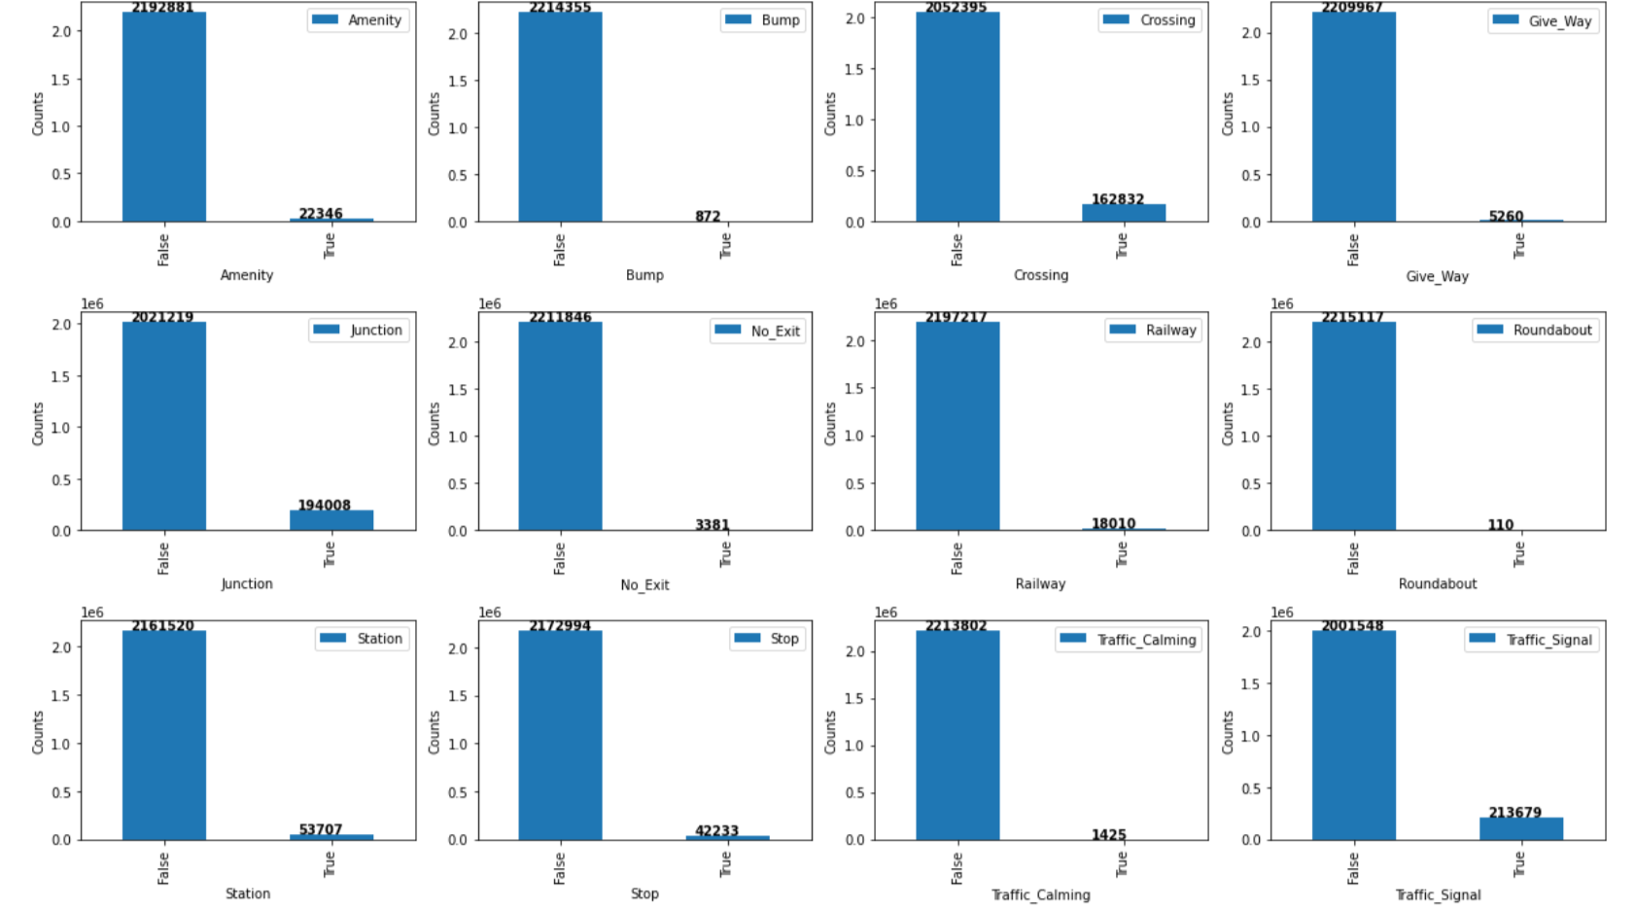
Categorical features

Slide 19
Research Questions

Slide 20
Visibility and severity
Hypothesis testing for visibility and severity
H0: all classes of severity have same visibility
H1: different classes have different visibility
Not normal distribution, so can’t use anova
tested using Kruskal test
Based on the hypothesis testing, the P value is less than 0.05, so we reject the null hypothesis
We can infer that visibility does impact the severity of an accident

Slide 21
Traffic light vs Roundabout
Which is better at controlling severity of traffic: traffic light or roundabout
h0: both have same severity
H1: they have different severity
Based on the t-test and the p value of 0.174, we fail to reject the null hypothesis.
Can’t conclude traffic light is better than roundabout or vice versa.

Slide 22
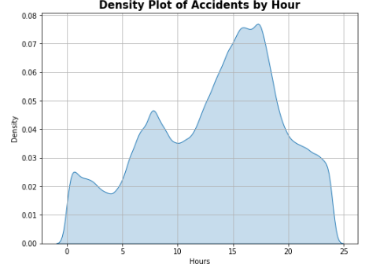
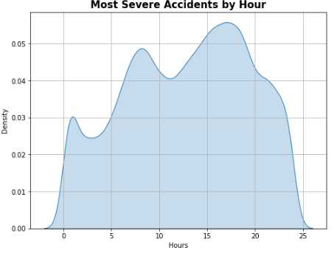
Time of day vs accident
Accidents peak at 4-6 PM
Most severe accidents also happen around 4-6 PM
Fridays are more prone to accidents

Slide 23
Machine Learning

Slide 24
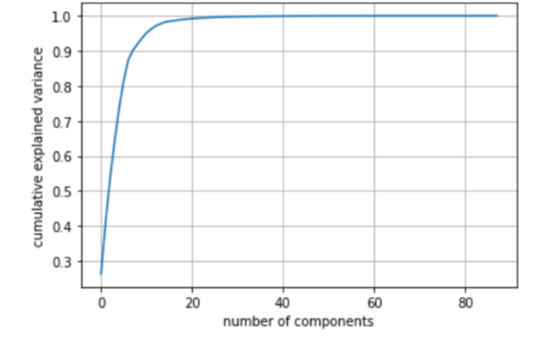
Initial Phase
Build ML model to predict the severity of accident
Limited the data to 2020 only
One hot encoding for weather conditions
PCA for dimensionality reduction to 25 from 80+ features
20:80 Train Test Split, hyperparameter Tuning and cross validation

Slide 25
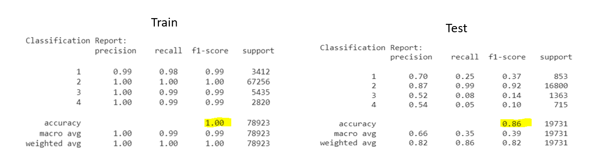
Random forest

Slide 26
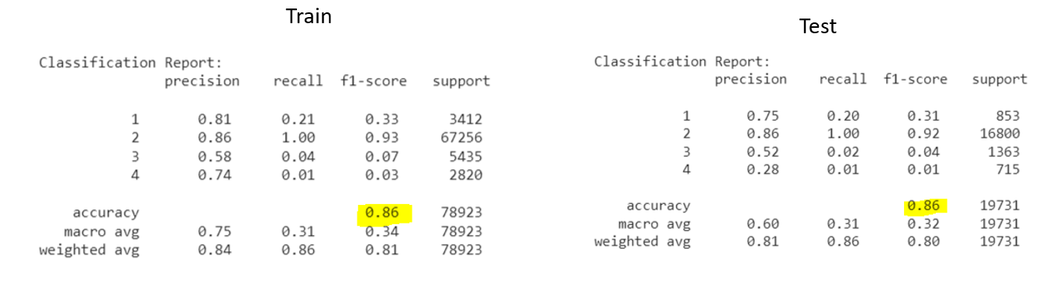
K Nearest neighbors

Slide 27
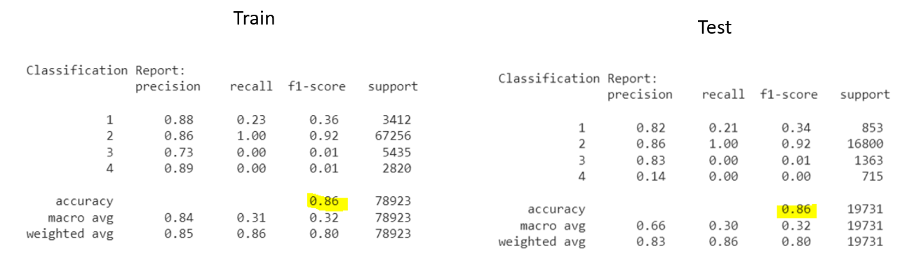
NEURAL NETWORK

Slide 28
Conclusion
Determination is based on the following:
Accuracy/F1 Score
Ease of implementation
Runtime
Although All 3 methods gave a similar accuracy of ~86%, random forest is the winner for all categories.

